Slide 1

www.revisual.co
Exploring data storytelling for different mediums

Slide 2
www.revisual.co
“The medium is the message”
- Marshall Mcluhan
Notes:
🌐 The Medium: The Environment of Experience
Body: The medium is the experiential environment in which a data story lives. It shapes pace, attention, perception, and the meaning we make.

Slide 3
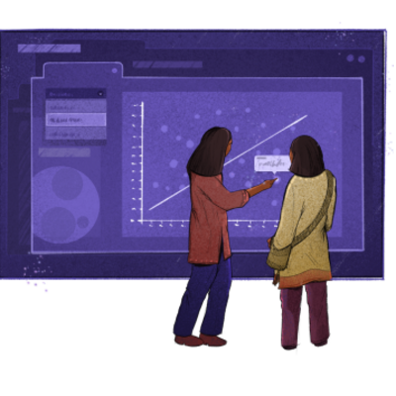


Different mediums to think about data storytelling
Print
Screen
Broadcast
Spatial
Material
Performance

Slide 4
www.revisual.co
Medium ≠ Form
Notes:
🌐 The Medium: The Environment of Experience
Body: The medium is the experiential environment in which a data story lives. It shapes pace, attention, perception, and the meaning we make.

Slide 5
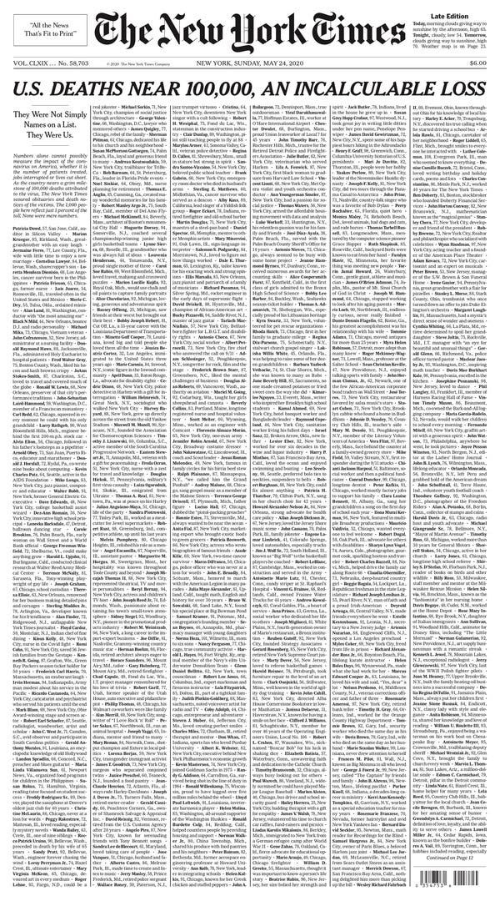
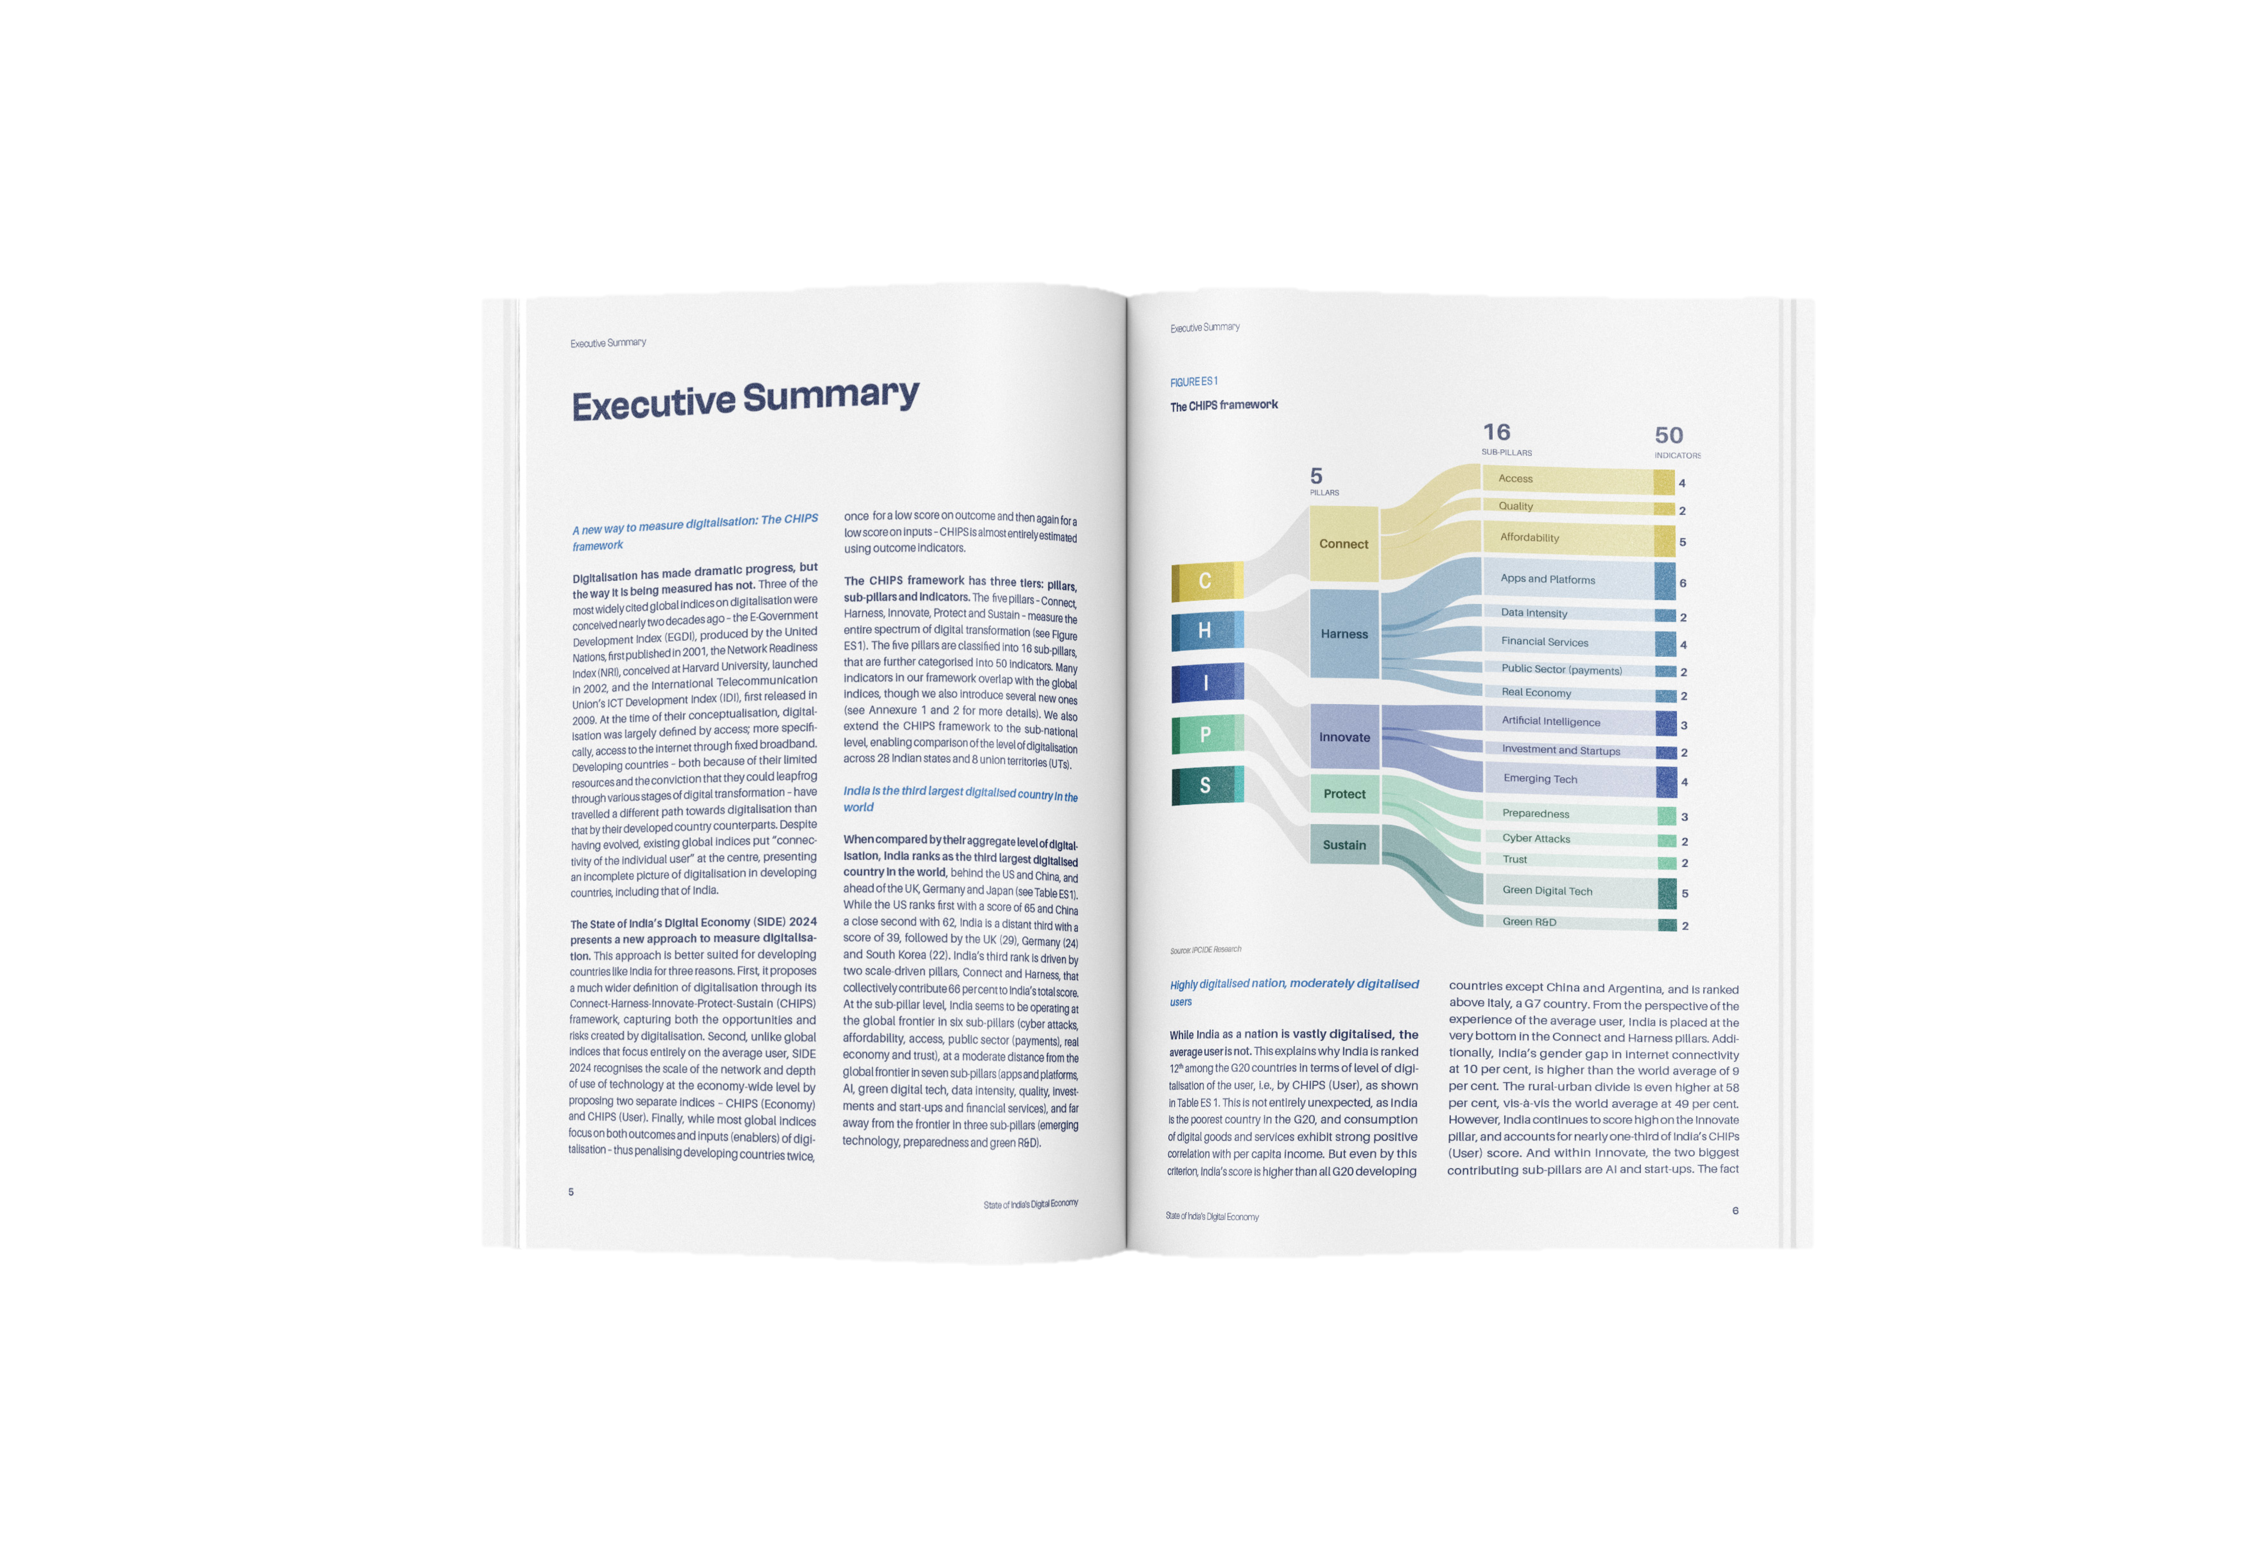
1. Print
100K deaths cover / NYTimes
Experience Principles
Sequential · Private · Low-tempo · Reflective · Re-readable · Archival · Fixed
Forms
Book · Report · Magazine · Newspaper · Pamphlet · Zine · Printed poster · Printed map
Revisual Labs for ICRIER

Slide 6

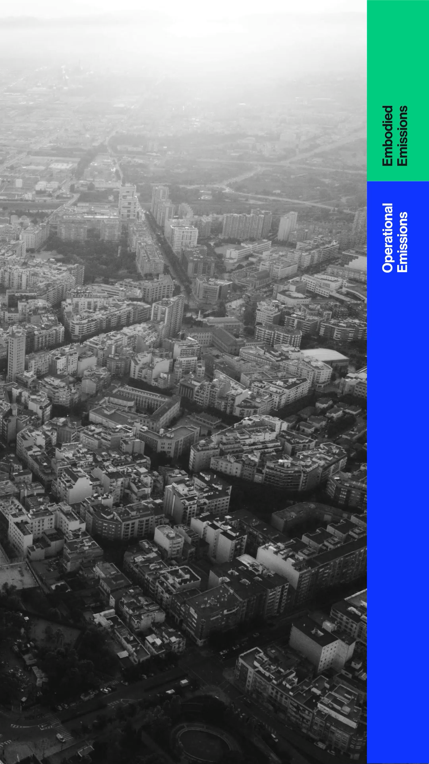
2. Screen
Experience Principles
Interactive · Navigational · Updateable · On-demand · User-paced Forms
Website · Dashboard · App · Blog · Reel · Carousel · Long-form video · E-reader · Smartwatch · Kiosk
Revisual Labs for Godrej Design Lab

Slide 7
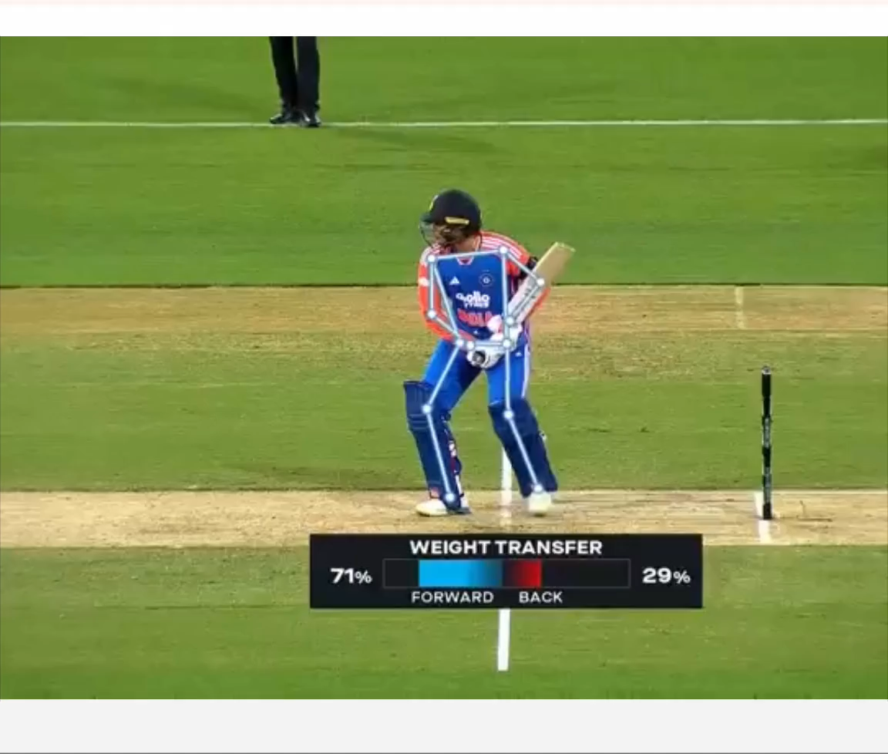
3. Broadcast
Experience Principles
One-to-many · Time-bound · Passive reception · Collective pacing
Forms
TV news · Radio · One-way livestream · News package · Documentary · Cinema
Fox Sports

Slide 8
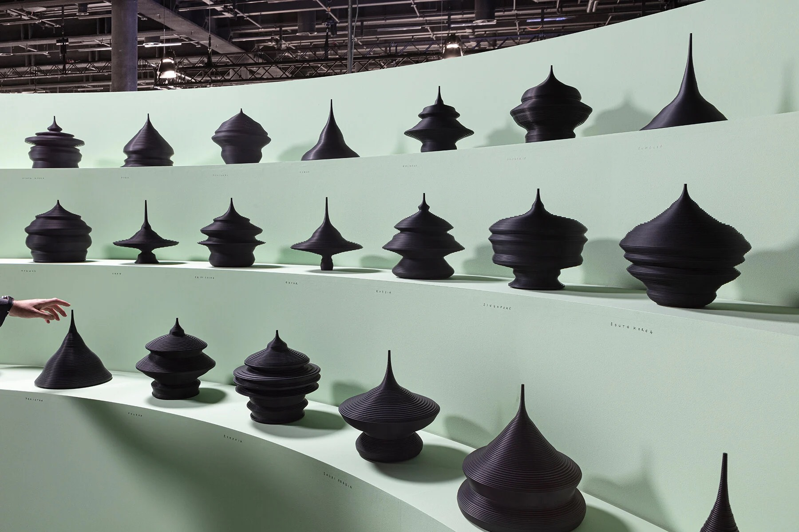
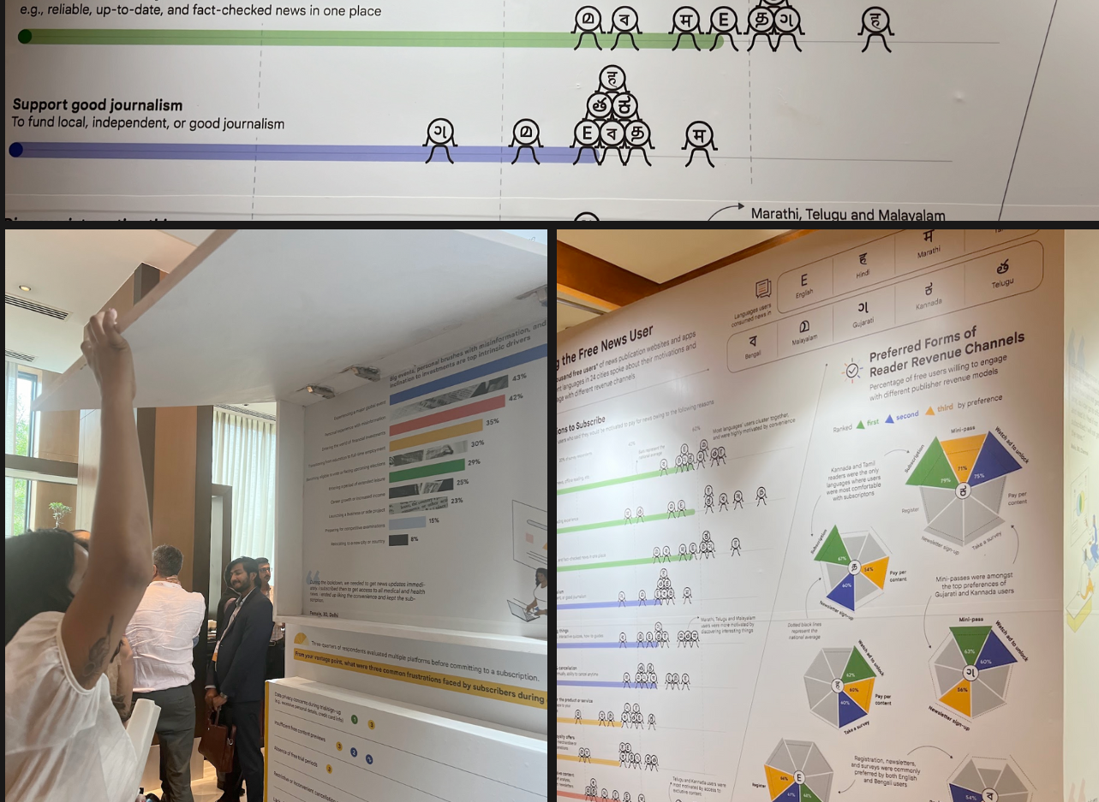
State of the World as Population Pyramids by Mathieu Lehanneur
4. Spatial
Experience Principles
Co-located · Ambient · Navigational · Atmospheric · Spatial memory
Forms
Museum wall · Gallery installation · Popup exhibit · Public data wall · Wayfinding · Public signage
Revisual Labs for Google News Summit

Slide 9
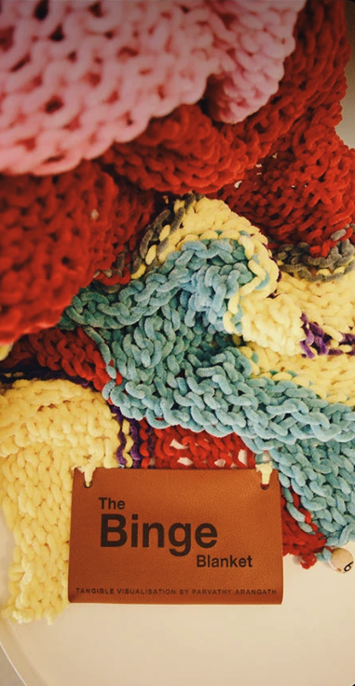
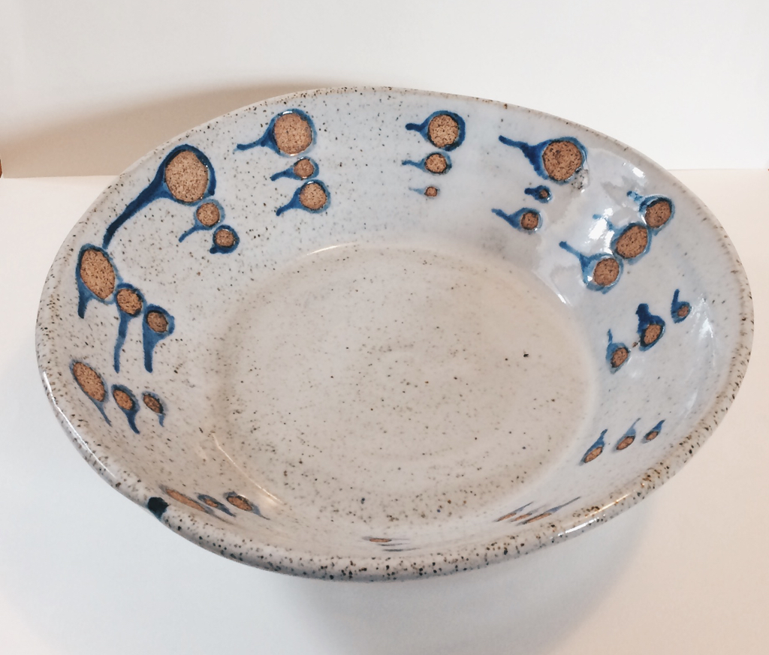
Binge Blanket / Parvathy Raju Arangath
5. Material
Experience Principles
Tactile · Textured · Visceral · Physical presence · Slow · Intimate · Permanence
Forms
Textile · Quilt · Pottery · Jewellery · Cards · Sculpture · Ceramics · 3D-printed object · Physical token
Data Pottery / Alice Thudt

Slide 10
6. Performance
Experience Principles
In-the-moment · Time-bound · Irreproducible · Embodied presence · Emotional · Reciprocal
Forms
Workshop · Talk · Theatre · Ritual · Game · Group dialogue

